Slide 1
Understanding ADHD
Hannah Wright
New River Outreach Advisory Teacher

Slide 2
Today’s objectives:
To think about the core behaviours and diagnosis of ADHD
To discuss how this is experienced and supported in the classroom
To think about how we can support our children at home

Slide 3
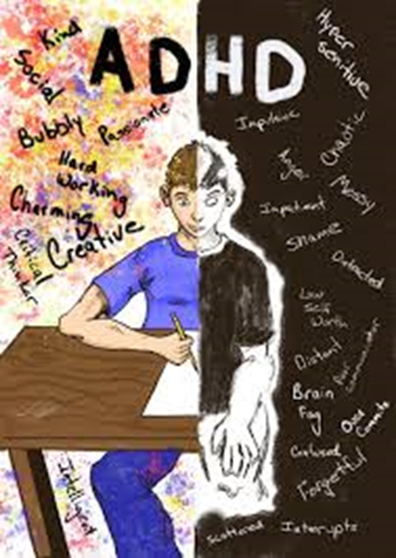
What is ADHD?
ADHD is a type of neurodiversity which causes executive dysfunction, That means the brain will not develop in a typical way.
Profiles can be seen as 'spiky' and children often display real strengths.
It is not a cognitive impairment, so you can be extremely able and still display symptoms.
Notes:
https://kidshealth.org/en/parents/adhd.html
Video – lets talk about ADHD
Executive function is a person’s ability to manage their own emotions, thoughts and actions. This is disrupted and challenging

Slide 4
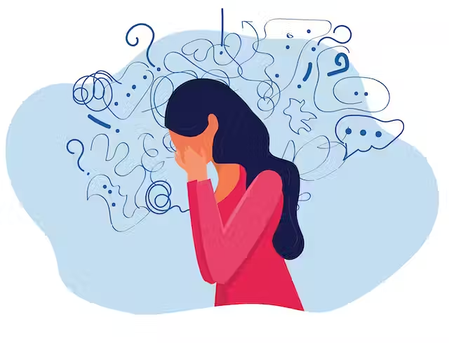
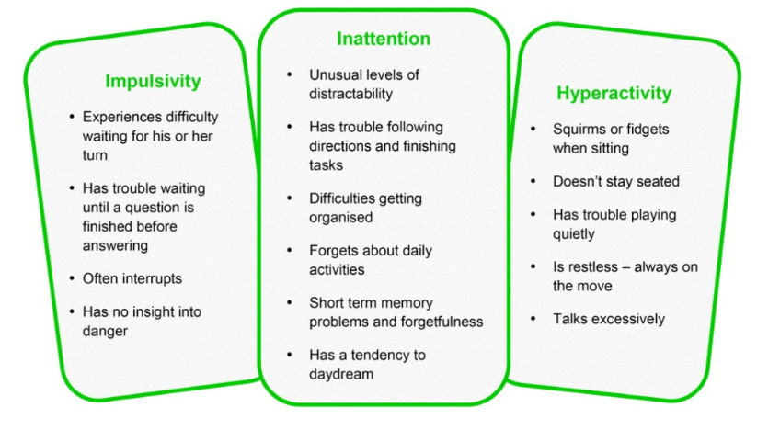
Core Behaviours of ADHD
Notes:
Inattention
(deficit)
Hyperactivity
Impulsivity
Fails to give close attention to detail or makes careless mistakes.
Has difficulty sustaining attention in tasks or play activities.
Easily distracted from tasks and play activities.
Does not seem to listen when spoken to directly.
Does not follow instructions through and fails to complete work.
Has difficulty in organising tasks and activities.
Avoids, dislikes or is reluctant to engage in tasks that require sustained mental effort.
Loses things – work, pens etc
Is distracted while they are on their way somewhere and will then be late, if arriving at all.
Fidgets.
Leaves seat.
Runs around when it is inappropriate.
Has difficulty doing anything quietly.
Is ‘on the go’ or acts as if driven by a motor.
Talks excessively.
Is over-excitable.
Acts without thinking about the consequences.
Blurts out answers before questions have been completed.
Blurts out their thoughts, especially in stressful situations and when they are being challenged about their behaviour.
Has difficulty waiting for a turn.
Interrupts.

Slide 5
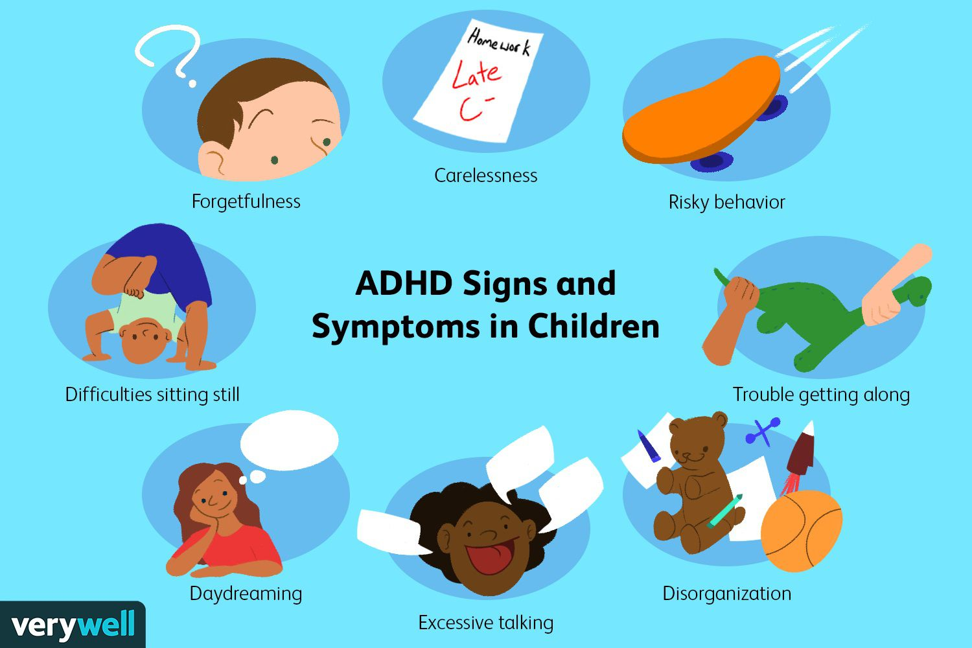
But what does this look like?
Notes:
Over-amplification “Those with ADHD are highly susceptible to stimuli (sights, sounds, thoughts etc) that may barely register in others but trigger intense and often impulsive responses in them.”
They know what they are supposed to do, but are unable to do it.
A lot of the language that we use around behaviour is often linked to choice/ refusal – make the right choice, didn’t choose the right path. Must remember that behaviour is not a choice it is a response.
“that wheel chair user refused to walk up the stairs”

Slide 6
The stats!
Boys are more likely to be diagnosed than girls, with a ratio of around 4:1
Estimated that 5% of children in the UK have ADHD
Most children with ADHD continue to have symptoms into their teens
Prescriptions information indicates that 8.2% of people who have ADHD are in receipt of ADHD medication
Two thirds of these CYP will take ADHD symptoms into adulthood​
More prevalent in those that have high ACE score (Adverse Childhood experience) or an experience of complex trauma.

Slide 7
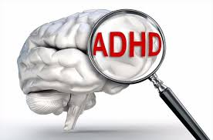
Diagnosis
There is no one cause of ADHD.
It is considered a result of a complex interplay between genetic and environmental factors.
A diagnosis is made following gathering systematic information; school observations, clinical interviews with parent and child, use of psychometrics, discussions with the network.
Information is discussed in a multi-disciplinary team and with families to determine the usefulness (or not) of a diagnosis
For a diagnosis, symptoms need to be present in two or more settings for a sustained period of time.
Notes:
Genetic factors being responsible for 70%-80% of the probability​.

Slide 8
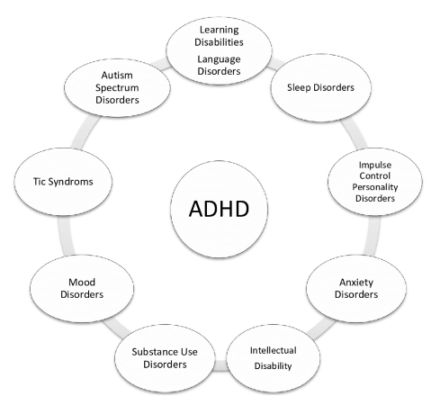
Comorbidity of ADHD
50 to 70% of individuals with autism spectrum disorder (ASD) also present with comorbid attention deficit hyperactivity disorder (ADHD).
Roughly 80 % of those with ADHD are diagnosed with at least one other psychiatric disorder sometime during their life.
The most common are anxiety, depression, learning differences, sensory processing disorder, and ODD.
Fifty percent of children diagnosed with ADHD have comorbid tic disorder.
ADHD related symptoms have been reported in 35% to 90% of children with Tourettes Syndrome (TS)
Another common comorbidity is ADHD and developmental coordination disorder (DCD), commonly known as dyspraxia, and dyslexia.

Slide 9
Impact on Learning
Working memory
Foresight
Hindsight
Sense of Time
Shifting Thoughts
Separating emotion from fact
Difficulty in reflecting and sequencing
Difficulty when judging the size of a problem
Negative or confusing internal speech
Struggle to positively narrate/ self talk.
Filtering out distractions
Motivation
Goal orientation
Regulation of sleep and alertness.
Notes:
Working memory – keeping things active in our mind for a given moment.
Steve will begin a task yet can not remember the next step
Foresight – predicting and planning for the future.
Steve may not consider the consequences of his actions.
Hindsight – learning from mistakes.
Steve might not draw on past experiences in inform his decision-making.
Sense of time.
Steve constantly arrives late to lessons.
Shifting thoughts – stopping one activity and switching to another (transitions).
Steve may still be thinking about the music he has been listening
to whilst he is in a science lesson.
Separating emotion from fact – difficulty in reflecting and judging the significance of what happens to them.
Steve may believe he is being victimised when spoken to about the quality of his work.
Internalised speech – self-talk, making reasoned choices.
Steve may choose to climb out of the window as it’s the quickest way to the playground.
Steve may hit another child in response to feeling hurt
Filtering out distractions
Steve misses what his teacher said because he is busy listening to a friend’s conversation or what is going on outside the classroom.
Regulation of sleep and alertness – difficulties in waking, getting
to sleep and keeping alert when on task.
Motivation – needing immediate reward/gratification.
Goal orientation - chronic procrastination.
Steve keeps putting off starting tasks.

Slide 10
Shame and self esteem
Many pupils with ADHD report intense feelings of shame about their behaviour and how they are seen.
They don't want to behave that way, but the Impulsivity means that do not have the capacity or the option to change this behaviour in the way that neuro typical children do.
Often seen as 'liars' or 'story tellers’. This may be as they have not understood a clear sequence of events, or feel too ashamed to be able to admit what they know.
Historic scepticism about ADHD. Many people still see it as a result of poor parenting.
Roughly 80 % of those with ADHD are diagnosed with at least one other psychiatric disorder sometime during their life.
Notes:
“ADHD patients are uniquely vulnerable to shame affect and emotion in a number of ways. The most obvious is that their impulsive actions and distractibility draw negative attention to them as soon as they enter any traditional educational system. They stand out from the other kids when they cannot sit still or continually interrupt others with their actions or their words. The attention they receive in such situations depends upon the skill, training, and stress level of their teachers. Even the best trained, most skilled, and most tolerant teachers, however, have difficulty managing hyperactive students if their class is large and they feel pressure from administrative demands about the amount of academic material they are required to finish each semester. When it becomes necessary to discipline and ADHD student, that child is going to experience shame. While the shame may well be appropriate to an admonition to behave in a less disruptive manner, the untreated ADHD child has little or no control over his or her distractibility and subsequent disruptiveness. As a result, the shaming interactions between teacher and student are likely to be repeated and intensify as both become more frustrated about the situation.”
The Upside of Shame, Kelly & Lamia
The former Government white paper, ‘Back on Track’, states that 66% of permanently excluded children and 75% of children in PRUs have special educational needs.29
Children with ADHD have more than 100 times greater risk of being permanently excluded from school than other children:1
39% of children with ADHD have had fixed term exclusions from school
11% of excluded children with ADHD have been excluded permanently.
The social impact of exclusion is well established, with evidence showing an increased likelihood of antisocial and criminal behaviour:1
49% of male and 33% of female sentenced prisoners were excluded from school.
Though it would be incorrect to suggest that ADHD is synonymous with antisocial behaviour, the Youth Crime Action Plan identified ADHD as one of the main risk factors of criminal offending during childhood.30

Slide 11
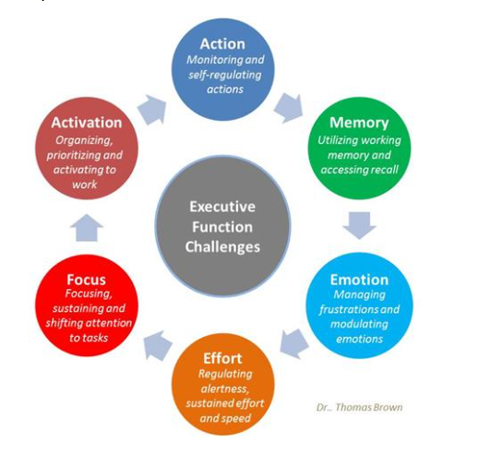
Considering ADHD & executive function
“The most practical way to view ADHD...is as a developmental delay in executive function.”
Dr Mark Bertin, M.D.
Focus on short-term goals
Reward work
Play music
Teach students about the brain
Allow them time to calm down
Include mindfulness activities

Slide 12
Structure reflection
Reduce demands on sustained attention (chunking)
Allow movement/ regulation breaks
Empathise!
Lots of visual support (duel coding)
Praise for calm and appropriate behaviours (also acknowledge that this takes up a lot of energy!)
Classroom Strategies
(that we can also try at home!)
Use name to gain pupils’ attention before addressing them.
Get alongside and do with the child – reduces demand
Reduce language
Minimise distractions
Structure free time
Notes:
Teach skills to complete task
Use timers
Follow completion with praise and rewards
Break down large tasks into steps using written checklists
Reduce demands on sustained attention
structure activities to ensure short intervals and regular breaks
Check individual’s understanding of set task
Ensure you test knowledge not attention span
Reduce language
Give one instruction at a time
Write down class rules to remind appropriate behaviour e.g., raise your hand, no talking whilst teacher is talking
Write instructions down
Use personal white boards
Ensure children are making eye contact before instructions are given
Minimise distractions
consider where child is seated not near heaters,
windows, other loud pupils, sit them next to good role models
Praise for calm and appropriate behaviours
Structure free time!
Give errands for break and lunch time
Engage in structured play with clear boundaries
Give regular movement breaks
give jobs that require movement e.g., register monitor, run errands, hand out books, read out activity to class
whole class movement activities (body poll, wiggle-wiggle)
Not in the moment, however following incidents allow for time for reflection and problem solving. Remember: ADHD is not not knowing what to do, but not doing what you know
Get alongside the child with ADHD – what can be different next time, empathise that it didn’t work out that time!
Comic Strip conversations
- what happened before, during and after
- what was the other thinking, feeling, doing?
- what could be different next time?

Slide 13
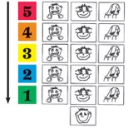
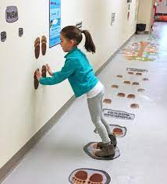
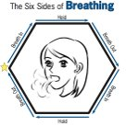
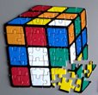
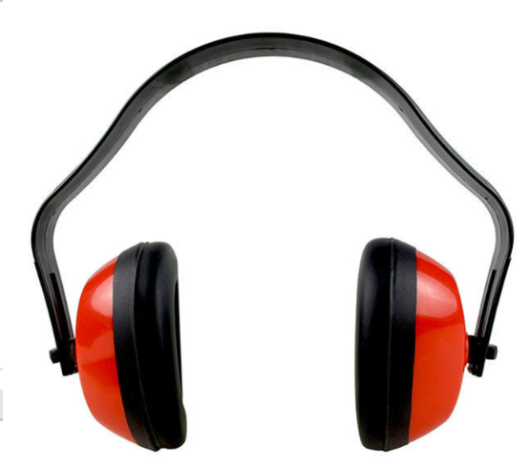
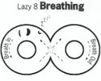
Think Sensory!
CALMING
ALERTING
Notes:
Chewlery (jewelry made of strong chewable plastic).
Changing workstations / moving around the classroom.
Running errands e.g. taking something to the office.
Cleaning the board.
'Chair press-ups'
Bear Hug
Swing/rock
Blow Bubbles
Classical music
Roll on exercise Ball
Trampoline
Blanket Roll
Lazy 8 Breathing​
The Six sides of Breathing​
My Calming Sequence​
​
Activities:
Puzzles​
Listen to Classical Music​
Draw/Paint/Coloring​
Origami​
Play-Doh/clay​
Read​
Mindfulness​
COUNTING

Slide 14
What children with ADHD want staff in school to remember….
Our brains work differently ( and we aren`t just naughty)
ADHD ≠ Naughty
You can`t see ADHD!
I want you to let my family know when I have done something well!
We want to go on school trips!
I can’t always use what I’ve learnt to stop me making mistakes
Please help us by using “strategies in the classroom
Home learning takes hours
We get bored easily and it`s not our fault
We need to move!
We don`t always know why!
Our family need help and support
(not judgement!)

Slide 15
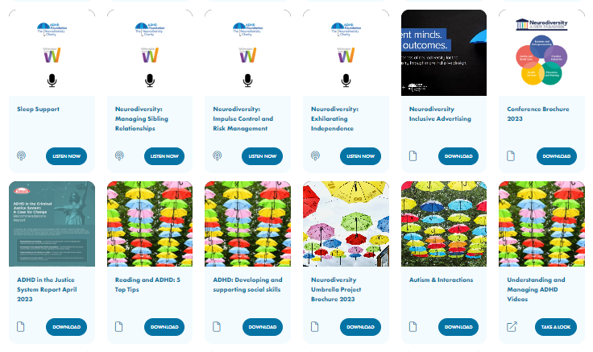
Further Reading – Or Listening
https://www.adhdfoundation.org.uk/resources/

Slide 16
Any Questions?
Evaluation
1. 24.01.2025
2. Staff name: Parent
3: School: St Johns Highbury Vale
4: Your email address – (leave blank unless seeking response from NRC team)
5: Understanding ADHD for parents
……
13. Email any questions/ queries/ follow ups.

