Slide 1
GDPR Information and Consent

Slide 2
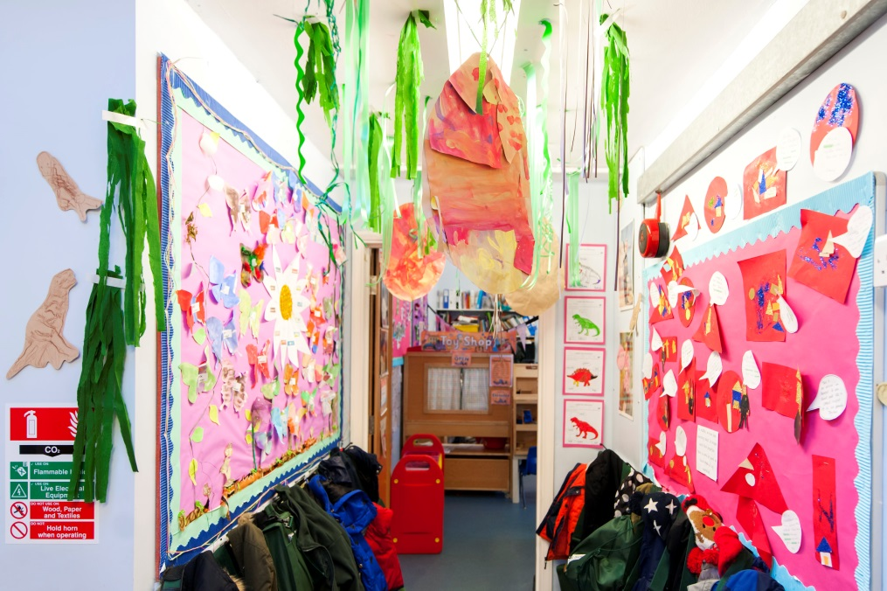
Data Protection Law in the UK changes from May 2018
Its now called the
General Data Protection Regulation
also known as GDPR
The Regulation is about protecting people in the modern information age
It gives more control to individuals and more responsibilities to organisations which collect and hold your Data
GDPR effects everyone
This booklet gives you information about how it effects you and your child and also asks for consent for a number of things
Consent is no longer ongoing and we will be required to renew consent annually. In addition to this you can withdraw consent at anytime
If you would like to discuss the content of this document, feel free to come and see me.
Neil Richardson
Headteacher

Slide 3
Your Child`s Data…
Sharing your Data…
As a school we require some essential data from you as parents. This data can be a simple and as routine as your address, a contact number or any medical conditions your child may have. Such information is not only legally required by the school, but also ensures that children and their families are well served by the school for routine matters.
In most cases, this data will be provided by you in written form but will then be processed and entered onto the schools information management system. (SIMS)
Be assured that our systems are:
Password protected
Restricted to those with a need to know
Regularly backed up externally
Managed in accordance with the law and local guidance
However, as a school we handle and use a much wider variety of data which may include our test data, referrals to social care and much more.
We will always endeavour to tell you what we are doing with your data. However, on occasion we may be required to pass on data to other people / agencies. The circumstances in which we would likely do so, would include:
At the request of a court law
Where we believe your child is at risk of harm
We are legally required to do so
At the request of the police
.
The School Duties..
The school must operate within the law (GDPR). This means that the school must:
Have a Data Protection Officer
Have policies for the management of data – accessible on the school website / school office
Respond to complaints or requests within one calendar month
Keep parents informed of what we do with any data
Inform you of any breach in our data that affects you
The school will not usually charge for any requests by parents. However, it would consider making a charge when requests are considered to be unfounded or excessive.
Data Protection Officer…
We have appointed a Data Protection Officer (DPO) to monitor our policies and procedures in relation to data through the LDBS. The school will receive three site visits per year and have will have whole school support.
If you have any concerns in the first instance speak with Anne-Marie School Business Manager, who is part of the schools GDPR team.

Slide 4
My child's full name is :……………………………………… Class…………………………………..
 | Date | Signature
ICT & Internet
I give my consent for the school to give my child access to the internet.
I give my consent for the school to provide my child with a school email address through the secure London Grid for Learning System.
I give my consent for my child to have access to the school’s ICT facilities and equipment.
I give consent for my child's computer files and internet sites visited to be checked.
Photographs
I give my consent and accept that the school may use photos and videos of my child to support learning activities.
I give my consent for my child's photo be displayed on the schools website.
I give my consent for my child's photo be displayed on notice boards on the schools perimeter.
I give my consent for my child's photo be displayed in the school newsletter and end of year school magazine

Slide 5
My child's full name is :………………………………………Class…………………………………..
 | Date | Signature
Health
I give my consent for my child to have check ups and information shared with the NHS School Nursing team and Health Visitors.
I give my consent for my child to have hearing checks with the NHS School Nursing team
I give my consent for my child to have Vision checks with the NHS School Nursing team
I give my consent for my child to have Weight checks with the NHS School Nursing team
I give my consent for my child to have Dental checks with the NHS School Nursing team
I give my consent for my child to have first aid administered by a qualified first aider at school
I give my consent for a first aider to administer medication to my child if it has been prescribed and I have completed a permission form via the school office.
I give my consent in the event of the school not being able to contact any of the emergency numbers on my child's file, for them to be taken to hospital and receive appropriate medical treatment.
I give consent for my child's photo and medical conditions such as Allergies and Asthma to be displayed in staff areas.

Slide 6
My child's full name is :……………………………………… Class…………………………………..
 | Date | Signature
Supporting your child's attendance and well being
I understand my child's attendance will be shared with the Local Authority as part of the schools statutory responsibility.
Displays around the school
I give my consent for my child's photo and name to be displayed around the school.
Consent for activities that are part of the Curriculum
I give my consent for the school to share my child's name with services relevant to the curriculum, eg. school trips/residential.
I give my consent for the school to share my child's name and date of birth with Islington Leisure Centre to support my child's swimming.
Consent for receiving digital communication
I give my consent to receive texts and emails from school to inform me about school information and FOSJ events.

Slide 7
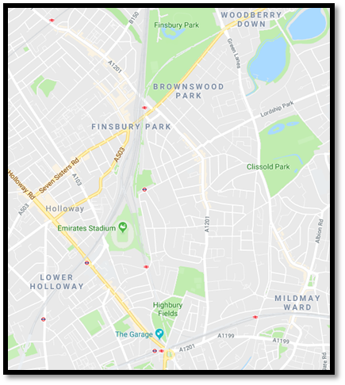
Annual Education Visits and Enrichment
My child's full name is :………………………………………… Class…………………………………..
This consent form is a blanket consent form which covers the child for the whole school year.
This means we will notify you via letter or text of trips for your information only and you do not need to give consent each time your child goes on an educational visit or represents the school at other events within our local area. (see map below)
If the school organises a trip that involves public transport, entering central London or outside our local area parents will be informed by letter, with key information shared. Parents will be asked to sign a separate permission form.
If you do not wish for your child to attend a particular
trip we would ask you put the reason in writing and return
this to the school office.
I am the parent/carer of the above child and I give my consent
for the 2018/2019 school year for my child to attend all local
Educational visits and enrichments that are within the local
boundaries
Signed:
Parent/Carer Name:
Date:

